Slide 1
Sequential data structure
Array
Linked list
Stack
What are some limitations of sequential data structure?
Fast or slow?
Insertion
Deletion
Searches

Slide 2
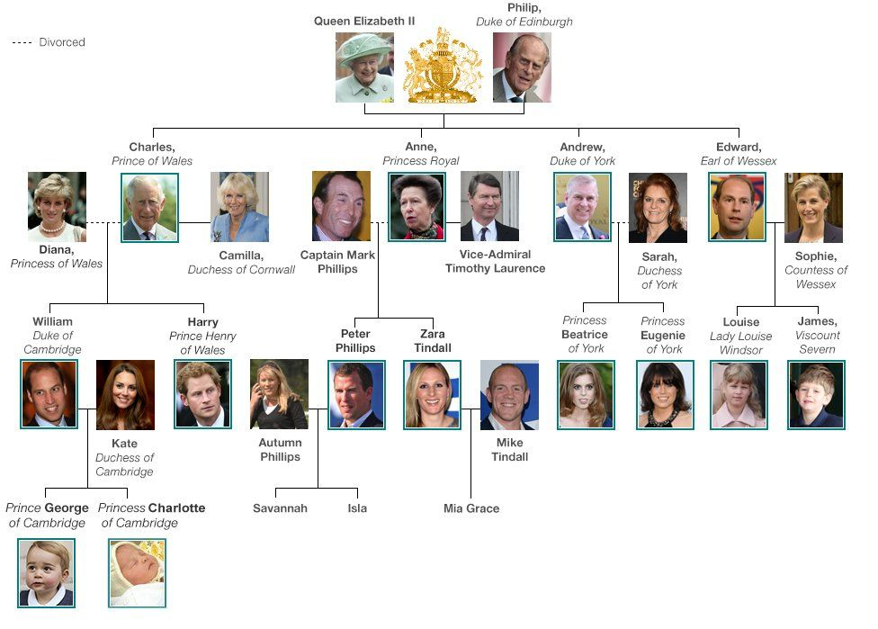
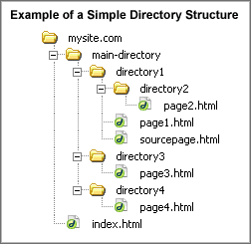
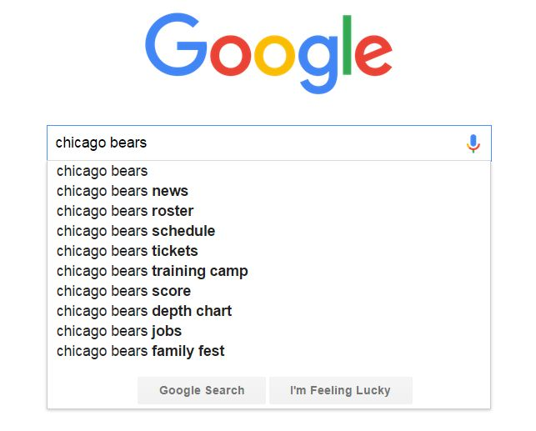
How can we organize hierarchical data?

Slide 3
Tree data structure
Productivity experts say that breakthroughs come by thinking “nonlinearly.”
"Sequentiality is an illusion" Kevin Skadron http://www.cs.virginia.edu/~skadron//

Slide 4
Tree Terminology
Node is a structure which may contain a value or condition, or represent a separate data structure. Each node of the tree is represented as a circle. Each node in a tree has zero or more child nodes.
Tree: is a data structure made up of nodes or vertices and edges without having any cycle and stores elements hierarchically.
Parent: A node that has a child is called the child's parent node. Each node has one parent with the exception of the root.
Child: a node extending from another node.
Root: The topmost node in a tree.
Sibling: Two nodes are siblings if they have same parent.
Leaf: a node with no children (external node).
Internal node: a node with at least one child.
Ancestor: a node reachable by repeated proceeding from child to parent. (Nodes on the path from the node to the root).

Slide 5
Descendant: a node reachable by repeated proceeding from parent to child.
Edge: a pair of nodes (u,v) such that u is directly connected to v. Children are connected to the parent by an arrow from the parent to the child. An arrow is usually called a directed edge or a directed branch.
Path: sequence of nodes. There is a unique path from the root to every node in the binary tree.
Length of a path: # of edges in path.
Level: The level of a node is defined by the number of connections between the node and the root.
Height of a node: Number of edges on the longest path from the node to a leaf. Height of leaf nodes = 0.
Height of a binary tree: Number of edges on the longest path from the root to a leaf (height of the root or maximum depth of any node). Height of an empty tree is -1.
Depth of a node is the number of edges from the node to the root (number of ancestors). Depth of root = 0.

Slide 6
root
depth = 0
Height =3
A
Level 0
parent
Left child
Right child
Level 1
B
C
siblings
Edge
depth = 2
Height =1
D
E
F
G
Level 2
E
Level 3
Right subtree
leaf
Left subtree

Slide 7

In a survey conducted in Summer 2015 by Northern Illinois University's Center for Government Studies, a third of employers said it is important to hire a recent college graduate who can communicate effectively in more than one language, and half said it will be important five years from now.
http://www.chicagotribune.com/business/ct-bilingual-employees-niu-0929-biz-20150928-story.html

Slide 8
Recursion
A function that calls itself
The function actually knows how to solve only the simplest case(s) ( base case(s)).

Slide 9
What is the output?
#include <iostream>
void countDown(int count)
{
std::cout << "push " << count;
countDown(count - 1);
}
int main()
{
countDown(5);
return 0;
}

Slide 10
#include <iostream>
void countDown(int count)
{
std::cout << "push " << count << '\n';
if (count > 1) // termination condition
countDown(count - 1);
std::cout << "pop " << count << '\n';
}
int main()
{
countDown(5);
return 0;
}
push 5
push 4
push 3
push 2
push 1
pop 1
pop 2
pop 3
pop 4
pop 5

Slide 11
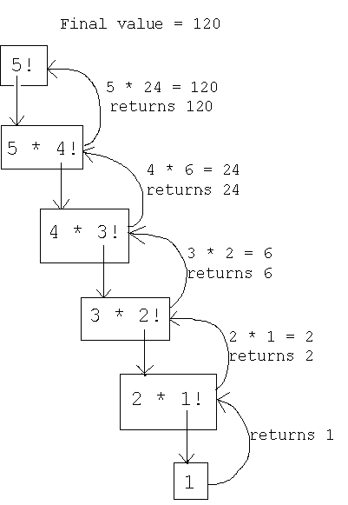
#include<iostream>
using namespace ::std;
long factorial(long number)
{
if (number <= 1)
return 1;
else
return (number * factorial(number - 1));
}
int main()
{
cout << factorial(5);
return 0;
}

Slide 12
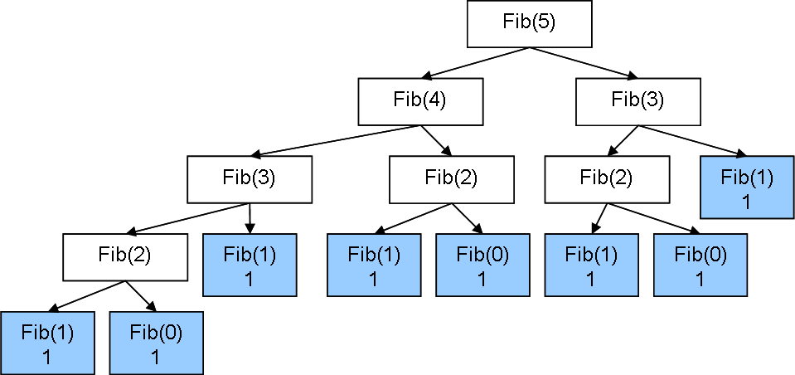
#include<iostream>
using namespace ::std;
long fibonacci(long n)
{
if (n <2)
return n;
else
return (fibonacci(n - 1) + fibonacci(n - 2));
}
int main()
{
cout << " Fibonacci of 5 = " << fibonacci(5);
return 0;
}
Fib(0) 0
Fib(0) 0
Fib(0) 0
Fibonacci of 5 = 5

Slide 13
Write a recursive function print_backwards, that receives a vector (e.g., 2,4,7) and prints it in reverse order (e.g., 7,4,2).
#include<iostream>
#include<vector>
using namespace std;
void print_backwards(vector<int> v)
{
}
int main()
{vector<int> v = { 2,4,7 };
print_backwards(v);
return 0;}

Slide 14
Write a recursive function print_backwards(), that receives a vector (e.g., 2,7,4) and prints it backwards on the screen (e.g., 4,7,2).
#include<iostream>
#include<vector>
using namespace std;
void print_backwards(vector<int> v)
{
if (v.size() > 0)
{
cout << v.back();
v.pop_back();
print_backwards(v);
}
}
int main()
{vector<int> v = { 2,4,7 };
print_backwards(v);
return 0;}

Slide 15
Write a recursive function to sum all the numbers in a vector
#include<iostream>
#include<vector>
using namespace std;
int findSum(vector<int> v)
{
if (v.empty())
return 0;
else
{
int last = v.back();
v.pop_back();
return last + findSum(v);
}
}
int main()
{vector<int> v = { 3,7,9 };
cout<<findSum(v);
return 0;}

Slide 16
Data structures
A group of data elements (members) grouped together under one name.
To access the members of an object we simply insert a dot (.) between the object name and the member name.
struct product
{
int quantity;
double price;
};
product apple, orange; // Many objects can be declared from a single structure type.
apple.quantity = 4; // Access member of a structure.

Slide 17
Pointers to structures
To access the members of a pointer to structure
Use the arrow operator -> (minus sign and greater than sign with no whitespace )
PointerToStruct->member
Which is equivalent to:
(*PointerToStruct).member
product apple, *ptr;
ptr = &apple;
ptr->quantity = 5
// OR
// (*ptr).quantity = 5;
More details http://www.cplusplus.com/doc/tutorial/structures/

Slide 18
#include <iostream>
using namespace std;
struct Time {
int hour;
int minutes;
int seconds;
};
void main()
{
Time current, *ptr;
current.hour = 11;
current.minutes = 2;
current.seconds = 30;
cout << " The time now = " <<current.hour << ":"<< current.minutes <<":"<< current.seconds;
ptr = &current;
ptr->hour++;
cout << "\n The time after 1 hour = " << current.hour << ":" << current.minutes << ":" << current.seconds;
}
The time now = 11:2:30
The time after 1 hour = 12:2:30

Slide 19
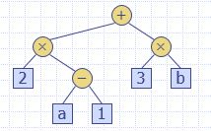
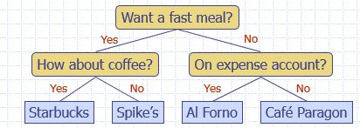
Binary Tree
Every node in a binary tree has at most two children.
Applications:
arithmetic expressions (e.g., (2 × (a - 1) + (3 × b)) )
decision processes (e.g., dining decision)
searching

Slide 20
Properties of Binary Trees
n = number of nodes
ne = number of external nodes
ni = number of internal nodes
h = height of a binary tree
Then the binary tree has the following properties:
h+1 ≤ n ≤ 2^{h+1} – 1
1 ≤ ne ≤ 2^{h}
h ≤ ni ≤ 2^{h} – 1
log(n+1) – 1 ≤ h ≤ n-1

Slide 21
For each node
The data stored in data
A pointer to the left child stored in left
A pointer to the right child stored in right
class Node
{
int data;
Node *left;
Node *right;
};
Pointer to root node is stored outside the binary tree. The root node defines an entry point into the binary tree.

Slide 22
Write a C++ program to find the maximum depth of a tree
#include<iostream>
using namespace std;
class Node
{
public:
int data;
Node* left;
Node* right;
};
/* Helper function that allocates a new node with the given data and NULL left and right pointers.*/
Node* newNode(int data)
{
Node* n = new Node; // dynamically allocate new objects of type Node
n->data = data;
n->left = nullptr;
n->right = nullptr;
return(n);
}
Replace with constructor

Slide 23
int main()
{
Node *root = newNode(1);
root->left = newNode(2);
root->right = newNode(3);
root->left->left = newNode(4);
root->left->right = newNode(5);
cout << "The maximum depth is " << maxDepth(root);
return 0;
}
Replace with insert function

Slide 24
/* Compute the "maxDepth" of a tree -- the number of edges along the longest path from the root node down to the farthest leaf node.*/
int maxDepth(Node* n)
{
if (n == nullptr)
return -1; // depth of an empty tree
else
{
// compute the depth of each subtree
int lDepth = maxDepth(n->left);
int rDepth = maxDepth(n->right);
// use the larger one
if (lDepth > rDepth)
return(lDepth + 1);
else
return(rDepth + 1);
// OR just
// return 1 + max(maxDepth(n->left), maxDepth(n->right));
} }

Slide 25
Binary Tree Traversal
The item insertion, deletion, and lookup operations require that the binary tree be traversed or visit each node of the binary tree.
Must start at the root, and then we can first visit the
node or
subtrees
These choices lead to different recursive traversal algorithms
Depth-first traversal
Inorder
Preorder
Postorder
Breadth-first traversal

Slide 26
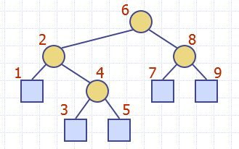
Inorder traversal (LNR)
Traverse the left subtree
Visit the node (We cannot do step 2 until we have finished step 1).
Traverse the right subtree
void inorder(Node *p)
{
if (p != NULL)
{
inorder(p->left);
cout << p->data;
inorder(p->right);
}
}

Slide 27
2) Preorder traversal (NLR)
Visit the node
Traverse the left subtree
Traverse the right subtree
void preorder(Node *p)
{
if (p != NULL)
{
cout << p->data;
preorder(p->left);
preorder(p->right);
}
}

Slide 28
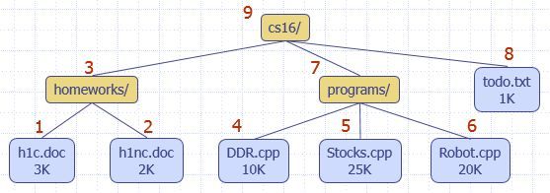
3) Postorder traversal (LRN)
Traverse the left subtree
Traverse the right subtree
Visit the node
Application: compute space used by files in a directory and its subdirectories
void postorder(Node *p)
{
if (p != NULL)
{
postorder(p->left);
postorder(p->right);
cout << p->data;
}
}

Slide 29
4) Breadth-first traversal ( level-order ): the root is processed first, all its children are processed next, then all of their children, etc. down to the bottom level.
void levelOrder(Node *p) {
q.push(p); // Push the root
while (!q.empty())
{
Node *v = q.front();
cout << v->data;
if (v->left != NULL)
q.push(v->left);
if (v->right != NULL)
q.push(v->right);
q.pop();
}}

Slide 30
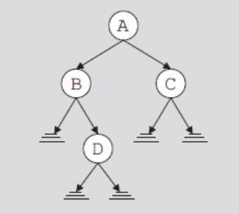
Exercise: Traverse the following binary tree: (a) in inorder; (b) in preorder; (c) in postorder. Show the contents of the traversal as the algorithm progresses.
Inorder sequence: B D A C
Preorder sequence: A B D C
Postorder sequence: D B C A
level-order sequence: A B C D

Slide 31
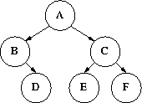

Pre-Order: A-B-D-C-E-F
In-Order: B-D-A-E-C-F
Post-Order: D-B-E-F-C-A

Slide 32
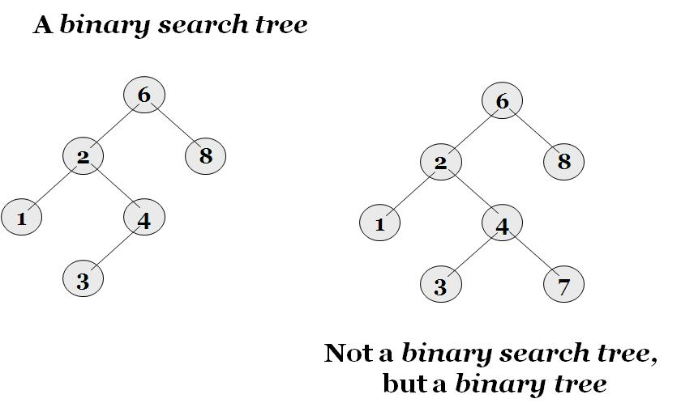
Binary Search Tree (BST)
The binary search tree is a binary tree with the following properties:
The key in each node must be greater than all keys stored in the left sub-tree, and smaller than all keys in right sub-tree.
Each subtree is, itself, a binary search tree.

Slide 33
Operations on Binary Search Trees
Insertion
Search
Traversal
Deletion
Find minimum
Find maximum
Successor: finds the next item in the tree that is greater than the current node
Predecessor: finds the previous item in the tree that is smaller than the current node

Slide 34
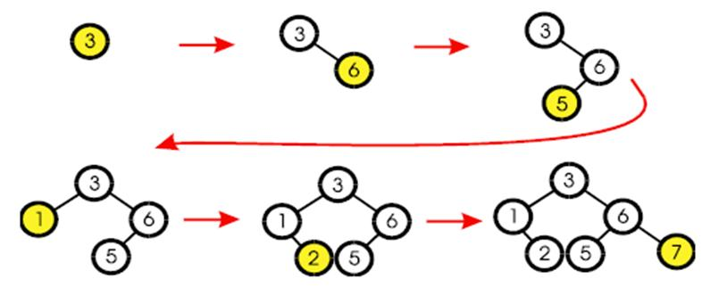
Inserting an item in BST
The first value inserted goes at the root.
Every node inserted becomes a leaf.
Insert left or right depending upon value.
Duplicate values:
Can be stored in another data structure (e.g., list).
Can all be kept in the left subtree, or all in the right subtree (the choice must be same for the whole implementation).
Need extra operations (e.g., getAll and removeAll)

Slide 35
void insert(Node *&ptr, int val)
{
if (ptr == NULL)
ptr = new Node(val);
else if (val < ptr->data)
insert(ptr->left, val);
else
insert(ptr->right, val);
}
The ptr parameter is not simply a pointer to a Node, but a reference to a pointer to a Node. This means that any action performed on ptr is actually performed on the argument that was passed into ptr.

Slide 36
C++ review
Classes (I) http://www.cplusplus.com/doc/tutorial/classes/
Friendship and inheritance http://www.cplusplus.com/doc/tutorial/inheritance/
Private and protected members of a class cannot be accessed from outside the same class in which they are declared. However, this rule does not apply to "friends".
Include guard: Used to avoid the problem of double inclusion
#ifndef HEADERFILE
#define HEADERFILE
// code
#endif
Example https://en.wikipedia.org/wiki/Include_guard

Slide 37
#include <iostream>
using namespace std;
class Point
{
public:
int a, b;
Point() // Default Constructor
{
a = 10;
b = 20;
}};
int main()
{
// Default constructor called automatically when the object is created
Point c;
cout << "a: " << c.a << endl << "b: " << c.b;
return 0;
}

Slide 38
#include<iostream> // A program to illustrate parameterized constructors
using namespace std;
class Point
{
private:
int x, y;
public:
Point(int x1, int y1) // Parameterized Constructor
{ x = x1;
y = y1;}
int getX() { return x; }
int getY() { return y;}
};
int main()
{
Point p1(10, 15); // Constructor called
// Access values assigned by constructor
cout << "p1.x = " << p1.getX() << ", p1.y = " << p1.getY();
return 0;
}

Slide 39
C++ Enumeration
An enumeration is a user-defined type whose value is restricted to one of several explicitly named constants (enumerators). Enumeration are defined using keyword: enum.

Slide 40
#include <iostream>
using namespace std;
enum seasons { spring, summer, autumn, winter };
int main()
{
seasons s;
s = summer;
cout << "summer = " << s << endl;
s = autumn;
cout << "autumn = " << s << endl;
return 0;
}
summer = 1
autumn = 2

Slide 41
C++ Templates
Templates are the foundation of generic programming, which involves writing code in a way that is independent of any particular type.
A template is a blueprint or formula for creating a generic class or a function. The library containers like iterators and algorithms are examples of generic programming and have been developed using template concept.
There is a single definition of each container, such as vector, but we can define many different kinds of vectors for example, vector <int> or vector <string>.

Slide 42
Function Template
The general form of a template function definition is shown here:
template <class type> returnType functionName(parameter list)
{
// body of function
}
Here, type is a placeholder name for a data type used by the function. This name can be used within the function definition.
The typename and class keywords can be used interchangeably to state that a template parameter is a type variable.
When the compiler sees an instantiation of the function template, for example: the call max(10, 15) in function main, the compiler generates a function max(int, int). Next Slide

Slide 43
#include <iostream>
#include <string>
using namespace std;
template <class T> T Max(T a, T b)
{ return a < b ? b : a; }
int main()
{
int i = 39;
int j = 20;
cout << "Max(i, j): " << Max(i, j) << endl;
double f1 = 13.5;
double f2 = 20.7;
cout << "Max(f1, f2): " << Max(f1, f2) << endl;
string s1 = "Hello";
string s2 = "World";
cout << "Max(s1, s2): " << Max(s1, s2) << endl;
return 0;}
Max(i, j): 39
Max(f1, f2): 20.7
Max(s1, s2): World

Slide 44
Function template with more than one type parameter
// 2 type parameters:
template<class T1, class T2>
void someFunc(T1 var1, T2 var2 )
{
// some code in here...
}

Slide 45
Class Template
Just as we can define function templates, we can also define class templates. The general form of a generic class declaration is shown here:
template <class type> class class-name {
.
.
}
Here, type is the placeholder type name, which will be specified when a class is instantiated. You can define more than one generic data type by using a comma-separated list.
Example – Stack

Slide 46
#include <iostream>
#include <vector>
#include <string>
using namespace std;
template <class T>
class Stack {
private:
vector<T> elems; // elements
public:
void push(T); // push element
void pop(); // pop element
T top(); // return top element
};

Slide 47
template <class T>
void Stack<T>::push(T elem)
{
elems.push_back(elem);
}
template <class T>
void Stack<T>::pop()
{
elems.pop_back();
}
template <class T>
T Stack<T>::top()
{
return elems.back();
}

Slide 48
int main()
{
Stack<int> intStack; // stack of ints
Stack<string> stringStack; // stack of strings
// manipulate int stack
intStack.push(7);
intStack.push(5);
cout << intStack.top() << endl;
// manipulate string stack
stringStack.push("hello");
stringStack.push("world");
cout << stringStack.top() << endl;
stringStack.pop();
cout << stringStack.top();
return 0; }
5
world
hello

Slide 49
Exercise
Write a function (mySwap) to swap two variables of generic type passed-by-reference.
Call the function 3 times using:
mySwap (int,int)
mySwap (char,char)
mySwap (double,double)
.. and print the new values after each call.

Slide 50
#include <iostream>
using namespace std;
template <typename T>
void mySwap(T &a, T &b) {
T temp;
temp = a;
a = b;
b = temp;
}
int main() {
int i1 = 1, i2 = 2;
mySwap(i1, i2); // Compiler generates mySwap(int &, int &)
cout << "i1 is " << i1 << ", i2 is " << i2 << endl;
char c1 = 'a', c2 = 'b';
mySwap(c1, c2); // Compiler generates mySwap(char &, char &)
cout << "c1 is " << c1 << ", c2 is " << c2 << endl;
double d1 = 1.1, d2 = 2.2;
mySwap(d1, d2); // Compiler generates mySwap(double &, double &)
cout << "d1 is " << d1 << ", d2 is " << d2 << endl;
}

Slide 51
Virtual
If there are member functions with same name in base class and derived class, virtual functions gives programmer capability to call member function of different class by a same function call depending upon different context. This feature in C++ programming is known as polymorphism which is one of the important features of OOP.
One of the key features of class inheritance is that a pointer to a derived class is type-compatible with a pointer to its base class.
A virtual member is a member function that can be redefined in a derived class, while preserving its calling properties through references. The syntax for a function to become virtual is to precede its declaration with the virtual keyword.

Slide 52
// virtual members
#include <iostream>
using namespace std;
class Polygon {
protected:
int width, height;
public:
void set_values(int a, int b)
{
width = a; height = b;
}
virtual int area()
{
return 0;
}
};

Slide 53
class Rectangle : public Polygon {
public:
int area()
{
return width * height;
}
};
class Triangle : public Polygon {
public:
int area()
{
return (width * height / 2);
}
};

Slide 54
int main() {
Rectangle rect;
Triangle trgl;
Polygon poly;
Polygon * ppoly1 = &rect;
Polygon * ppoly2 = &trgl;
Polygon * ppoly3 = &poly;
ppoly1->set_values(4, 5);
ppoly2->set_values(4, 5);
ppoly3->set_values(4, 5);
cout << ppoly1->area() << '\n';
cout << ppoly2->area() << '\n';
cout << ppoly3->area() << '\n';
return 0;
}
20
10
0

Slide 55
The member function area has been declared as virtual in the base class because it is later redefined in each of the derived classes.
Non-virtual members can also be redefined in derived classes, but non-virtual members of derived classes cannot be accessed through a reference of the base class: i.e., if virtual is removed from the declaration of area in the example above, all three calls to area would return zero, because in all cases, the version of the base class would have been called instead.
A class that declares or inherits a virtual function is called a polymorphic class.

Slide 56
Copy Tree
Shallow copy of the data
Obtained when value of the pointer of the root node used to make a copy of a binary tree
Identical (deep) copy of a binary tree
Need to create as many nodes as there are in the binary tree to be copied
Nodes must appear in the same order as in the original binary tree
Function copyTree
Given a pointer to the root node, makes a copy of a given binary tree.

Slide 57
void copyTree(Node* &copiedTreeRoot, Node* otherTreeRoot)
{
if (otherTreeRoot == NULL)
copiedTreeRoot = NULL;
else
{
copiedTreeRoot = new Node (otherTreeRoot->data);
copyTree(copiedTreeRoot->left, otherTreeRoot->left);
copyTree(copiedTreeRoot->right, otherTreeRoot->right);
}
}

Slide 58
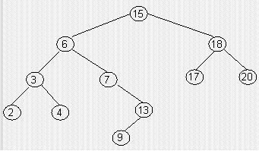
Successor
The successor of a node x, is node y, that has the smallest key greater than that of x.
(1) If x has a right subtree, then successor(x) is the left most element in that right sub tree.
(2) If x has no right sub tree, then successor(x) is the lowest ancestor of x (above x on the path to the root) that has x in its left sub tree.
Successor(15) = 17
Successor (7) = 9
Successor (13)= 15

Slide 59
Predecessor
The predecessor is the node that has the largest key smaller than that of x.
(1) If x has a left sub tree, then the predecessor is the right most element of that left sub tree.
(2) If x has no left sub tree, then predecessor (x) is the lowest ancestor of x (above x on the path to the root) that has x in its right sub tree.
Predecessor(6) = 4
Predecessor(15) = 13
Predecessor(17) = 15

Slide 60
Deleting from BST
First, find the item; then, delete it.
Binary search tree property must be preserved.
We need to consider three different cases:
Deleting a leaf
Deleting a node with only one child
Deleting a node with two children

Slide 61
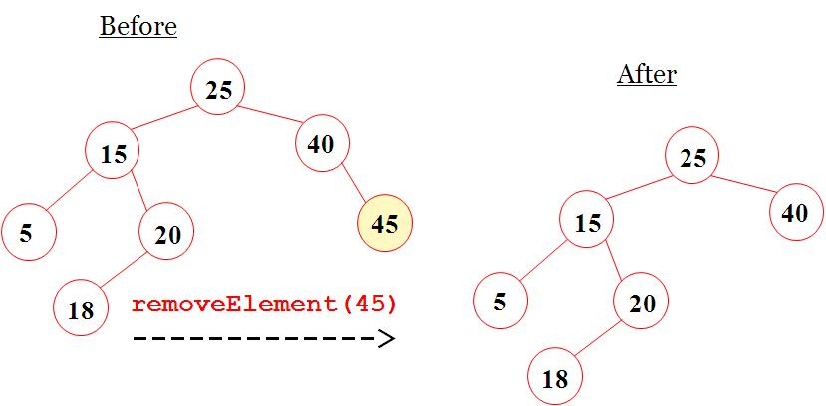
(1) Deleting a leaf

Slide 62
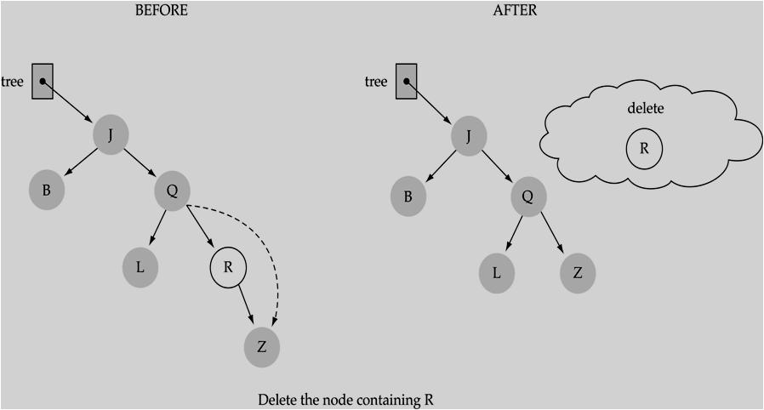
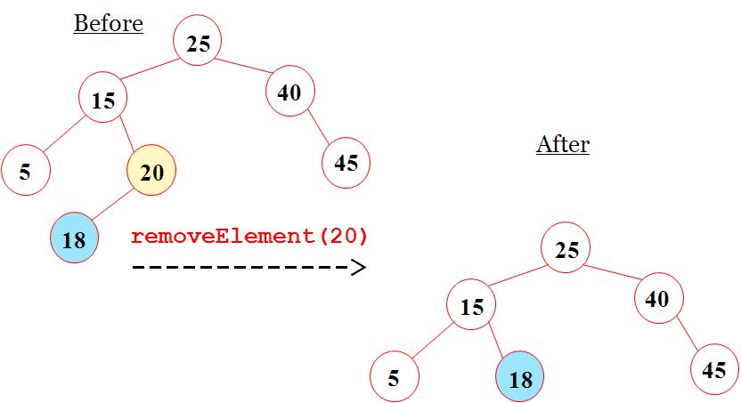
(2) Deleting a node with only one child

Slide 63
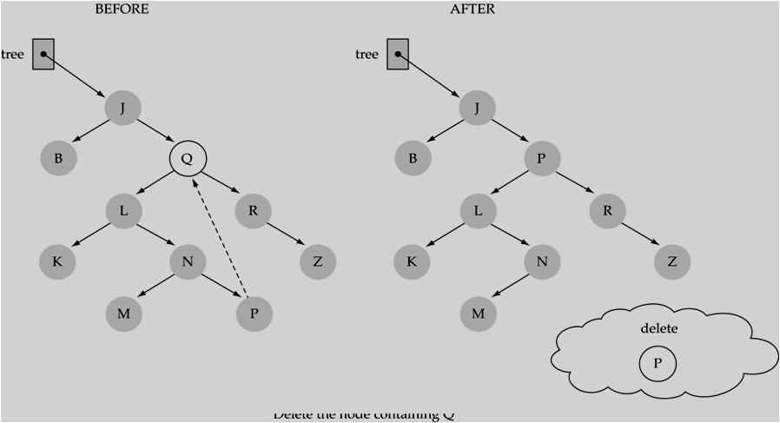
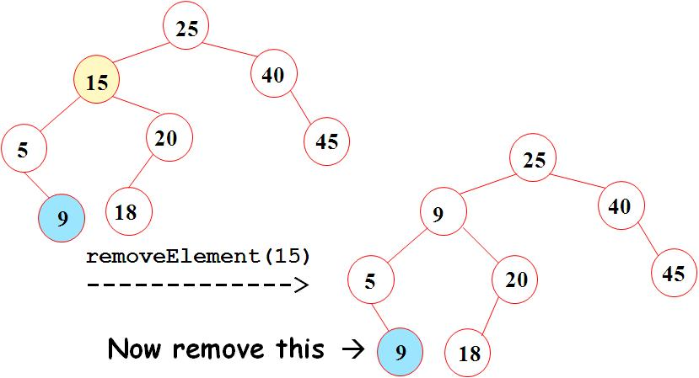
(3) Deleting a node with two children

Slide 64
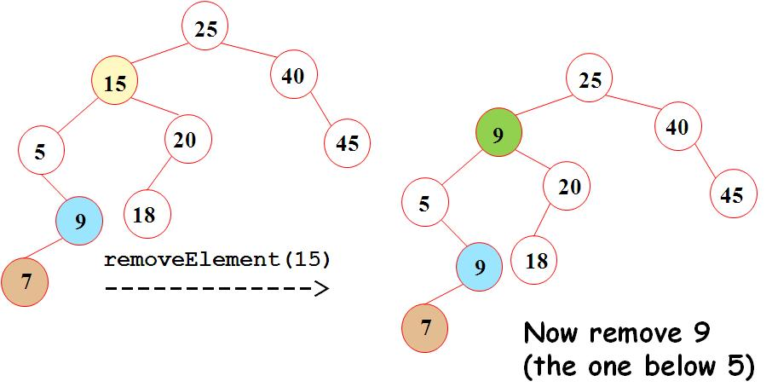
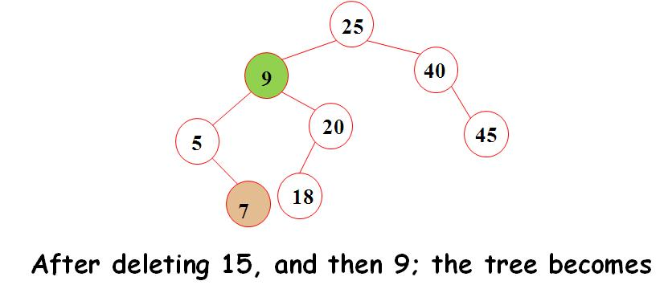

Slide 65
void findNodeToDelete(Node *&p, int item)
{
if (item < p->data)
findNodeToDelete(p->left, item);
else if (item > p->data)
findNodeToDelete(p->right, item);
else
deleteNode(p);
}
Notice that ptr argument is a reference to pointer. Like the insert function, the deleteNode function must have access to an actual pointer in the tree, to the node that is being deleted (not just a copy of the pointer).

Slide 66
void deleteNode(Node *&ptr)
{
int data;
Node *tempPtr = ptr;
if (ptr->left == NULL) {
// Reattach the right child or NULL
ptr = ptr->right;
delete tempPtr;
}
else if (ptr->right == NULL) {
ptr = ptr->left;
delete tempPtr;
}
else {
getPredecessor(ptr->left, data);
ptr->data = data;
findNodeToDelete(ptr->left, data);
}
}
void getPredecessor(Node * pt, int &data)
{
while (pt->right != NULL)
pt = pt->right;
data = pt->data;
}

Slide 67
Exercises
(1) Given a sequence of numbers: 11, 6, 8, 19, 4, 13, 5, 17, 43, 49, 16, 31, 32
Draw a binary search tree by inserting the above numbers from left to right
What is the height of the above tree?
Show the two trees that can be resulted after the removal of 19.

Slide 68
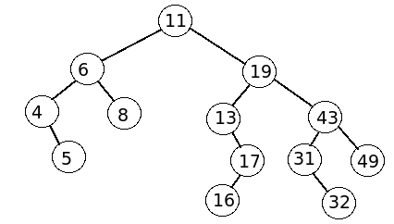
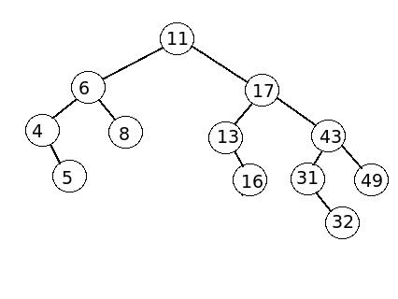
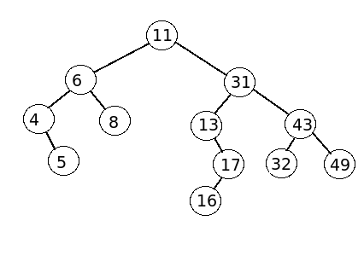
Answers
(a)
(b) What is the height of the above tree? 4
(c) Show the two trees that can be resulted after the removal of 19.

Slide 69
Which of the following traversals always gives the sorted sequence of the elements in a BST?
Preorder
Inorder
Postorder
depends on how the elements are inserted
In a Binary Search Tree, the largest element must
be the root.
be a leaf.
have at least one child.
have at most one child.
Given an array of comparable data. How would you sort it using a BST?

Slide 70
Binary tree Interview Questions
Define tree, binary tree and binary search tree. Now implement a function that verifies whether a binary tree is a valid binary search tree.
Google http://www.glassdoor.com/Interview/Define-binary-search-tree-Develop-a-procedure-to-verify-a-binary-search-tree-QTN_36765.htm
Amazon http://www.glassdoor.com/Interview/First-explain-what-a-tree-then-binary-tree-then-a-binary-search-tree-is-Now-implement-a-function-that-verifies-whether-a-QTN_228019.htm
http://www.geeksforgeeks.org/a-program-to-check-if-a-binary-tree-is-bst-or-not/
Find the minimum depth of binary search tree
Facebook http://www.glassdoor.com/Interview/Find-the-minimum-depth-of-binary-search-tree-QTN_127018.htm
http://www.geeksforgeeks.org/find-minimum-depth-of-a-binary-tree/
Find the longest path within a binary tree
Amazon http://www.glassdoor.com/Interview/Hardest-Q-was-Here-s-a-binary-tree-find-the-longest-path-within-it-So-find-a-path-between-any-two-leaf-nodes-where-the-QTN_465987.htm
http://www.geeksforgeeks.org/diameter-of-a-binary-tree/

Slide 71
Using recursion to traverse a binary tree
Microsoft http://www.glassdoor.com/Interview/using-recursion-to-traverse-a-binary-tree-QTN_7009.htm
Print the nodes on a tree level
Bloomberg L.P. http://www.glassdoor.com/Interview/gave-me-a-tree-of-3-level-and-provided-me-a-number-that-contains-the-level-number-and-asked-me-to-code-a-program-that-would-QTN_609076.htm
Write a function that takes 2 arguments: a binary tree and an integer n, it should return the n-th element in the inorder traversal of the binary tree.
Facebook http://www.glassdoor.com/Interview/Write-a-function-that-takes-2-arguments-a-binary-tree-and-an-integer-n-it-should-return-the-n-th-element-in-the-inorder-t-QTN_325122.htm
find lowest common ancestor of 2 nodes in a binary tree
Symantec http://www.glassdoor.com/Interview/find-lowest-common-ancestor-of-2-nodes-in-a-binary-tree-QTN_174437.htm
http://www.geeksforgeeks.org/lowest-common-ancestor-binary-tree-set-1/

Slide 72
Useful resources
Binary Search Trees (BSTs) - Insert and Remove Explained https://www.youtube.com/watch?v=wcIRPqTR3Kc
Print Ancestors of a given node in Binary Tree http://www.geeksforgeeks.org/print-ancestors-of-a-given-node-in-binary-tree/
Find sum of all left leaves in a given Binary Tree http://www.geeksforgeeks.org/find-sum-left-leaves-given-binary-tree/
How to handle duplicates in Binary Search Tree? http://www.geeksforgeeks.org/how-to-handle-duplicates-in-binary-search-tree/

Slide 73
Acknowledgement
Starting Out with C++ from Control Structures to Objects, 8th, Gaddis, 2014. Chapter 20 – Binary tree.
Data Structures Using C++ 2nd ed, D. S. Malik, 2009, Chapter 11 – Binary tree and B-trees.
Data Structures and Algorithms in C++ (2rd ed.), Michael T. Goodrich, Roberto Tamassia, David M. Mount, 2011, John Wiley & Sons. Chapter 7 – Trees.
Data Structures with C++ Using STL 2nd, Ford, 2001. Chapter 10.
http://www.geeksforgeeks.org/write-a-c-program-to-find-the-maximum-depth-or-height-of-a-tree/
http://sourcecodemania.com/binary-trees-and-binary-search-trees/
http://www.cs.cmu.edu/~adamchik/15-121/lectures/Trees/trees.html

